Slide 1

GenAI Developer Enablement Proof of Value Hackathon
October, 2023

Slide 2
Workshop Plan
Day | Timing | Duration | Activity
Tuesday | Morning | 09.00 - 10.00 | GenAI Developer enablement background & approach to workshop
Tuesday | Morning | 10.00 – 12.30 | Target state architecture definition & sizing
Tuesday | Afternoon | 13.30 – 17.00 | GenAI exploration and use case development End of day group review, demo & learnings
Wednesday | All Day | 9.00 – 17.00 | Continue GenAI exploration and use case development End of day group review, demo & learnings
Thursday | Morning | 9.00 – 12.30 | Finalise GenAI exploration Summarise conclusions of each use case
Thursday | Afternoon | 13.30 – 17.00 | Group review of GenAI effectiveness Next steps action planning

Slide 3

Use of GenAI in software development

Slide 4




Areas where GenAI tools can support software development
1
2
3
Code writing assistance
Remediating tech debt
Code understanding
What is it?
Accelerate code writing process and tests through tools like GitHub Copilot
Use GenAI tools to reduce time and effort in resolving complex tech debt
Use GenAI tools for documentation and code reviews to provide leverage to engineers
What are the benefits?
Makes development faster and more efficient
10-30% efficiency gain in code writing and testing process
Reduced hosting costs, mitigate drag on developer productivity and reduce operational risk
Additional benefits on reduced productivity drag and operational risk
Can mitigate senior engineer bottlenecks in software development process and accelerate roadmap over time
How easily can this be realised?
Easy to deploy tools and the way they are used is common across orgs
Challenge lies in converting faster code generation to efficiency & accelerated execution to drive scaled EBITDA impact
Underlying issues often complex and/or poorly understood
May require custom tooling - can be complex and iterative
Easy to deploy tools, review processes will naturally evolve over time
Difficult
Easy

Slide 5




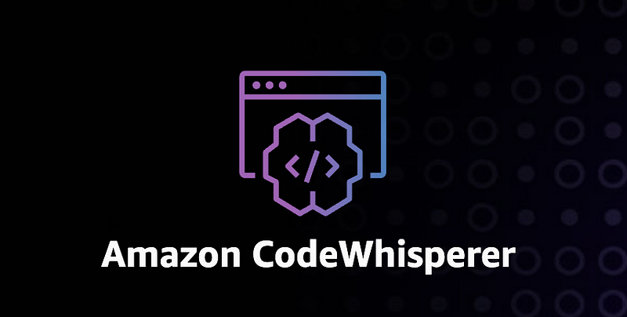
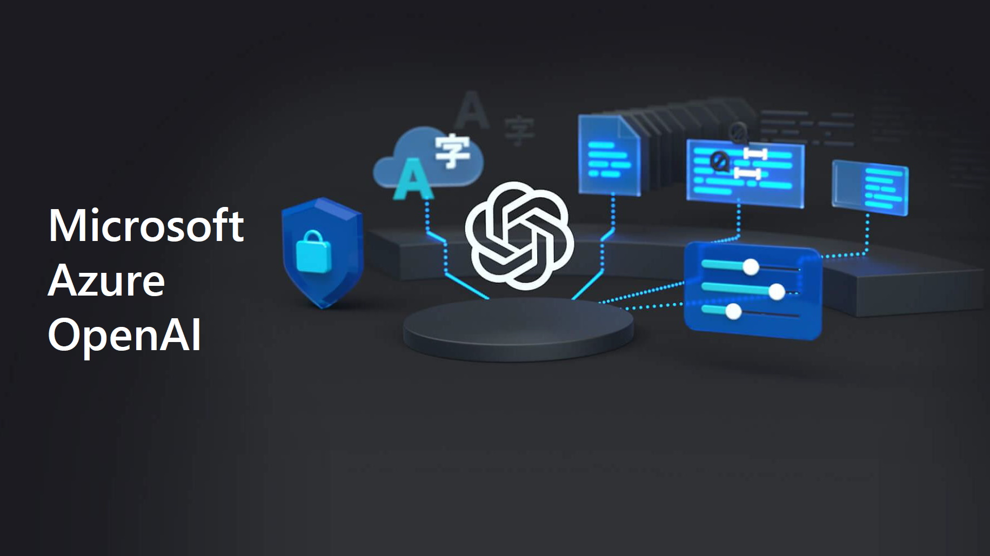

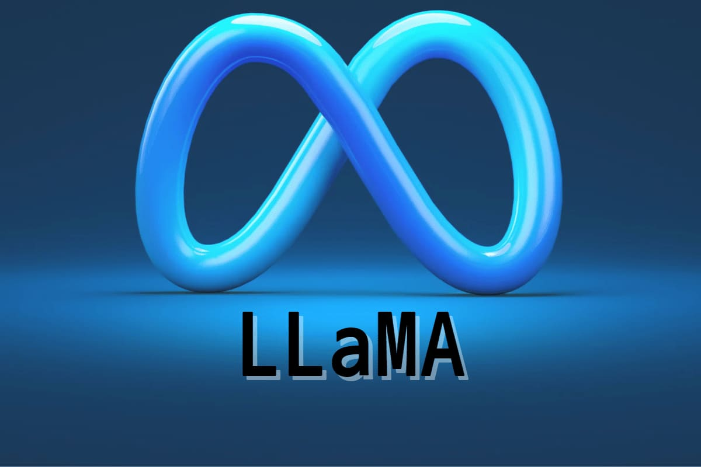



Tooling options
1
2
3
Code writing assistants
Code Understanding & Refactoring
Bedrock
microsoft/gpt-review
Easy

Slide 6
Use of Langchain
Framework for developing applications powered by language models
Parses common programming language source files to make best use of LLM context window
Eases automation of repetitive / mechanical programming tasks

Slide 7
Use of gpt-review
microsoft/gpt-review
Open source tool provided by Microsoft to perform 1st line review of pull requests using OpenAI or Azure OpenAI Services
Rapidly comments on PR contents potential changes for developer to consider – taking load off human reviewers
Easy to integrate to most CI pipelines

Slide 8
Activity – Tooling Profiles
Tools suited to tasks of different profiles
Code Discovery & Documentation
Write new code / tests
Refactor existing Code
Review Code
Simple refactor & small one time task
Complex refactor or requires repeat application of changes
Microsoft/gpt-review

Slide 9
Maximise Impact

Slide 10
Applicability to technical debt
1
All orgs have technical debt. Mapping initiative to impact areas supports prioritisation
Lowered Hosting costs
Lowered tech ops team costs
Increased Dev productivity
What are the impact areas across org and benefits of addressing TD?
Reduced Operational failures
Improved Tech and Org scalability
Mitigated Security risks

Slide 11
Software companies carry technical debt that has substantial impact
The case for addressing technical debt
There is significant value in addressing tech debt but it is challenging to prioritise
15-30%
True impact not well understood – dispersed across org and often hidden from leaders – but has significant long term drag on productivity and operational costs
Significant development effort and difficult to prove ROI as impact can accrue across many areas
Limited automated testing & coverage - long release lead times
Monolithic architecture limiting scalability
Estimated drag on developer productivity
10-25%
Business logic embedded in database driving increased hosting costs
Legacy acquired code in language that is difficult to support
Additional spend on hosting costs
AI tools are reducing the resources required and changing the ROI dynamic
Proper measurement and analysis can identify and unlock significant value
Substantially lower dev effort – can prove ROI with reduced investment and payback period

Slide 12
Hg framework to prioritise technical debt
2
Focus on measurable benefits that can be translated to EBITDA impact or cost avoidance. AI supports reduced cost to resolve, faster time to resolve and improved ROI
ROI / Payback of addressing tech debt
Measurable benefits translated to EBITDA impact
Reduced hosting costs
Avoided costs on technical operations and support teams
Improved R&D productivity -> reduced R&D costs or increased revenue with existing team
Cost of addressing tech debt
One-off development cost
Potential to reduce dev cost with AI tooling
Additional benefits as upside – reduced security risks and operational failures, improved scalability

Slide 13
Activity Effectiveness
Rapidly evolving technology, view as of Jul 2023
Activity | Activity Type | Engineer Level
 |  | Senior |  | Middle |  | Junior
 |  | Effectiveness | Time Spent | Effectiveness | Time Spent | Effectiveness | Time Spent
System Design | Code Analysis | Medium | Long | Low | Medium | Very Low | Very Short
Generate documentation | Code Analysis | Very High | Very Short | Very High | Very Short | Medium | Very Short
Understand code | Code Analysis | High | Very Short | High | Short | Medium | Medium
Perform code review | Code Analysis | Very High | Short | High | Medium | Very Low | Very short
Create code prototypes | Coding | Very High | Short | Medium | Very Short | Very Low | Very Short
Refactor code | Coding | High | Short | Medium | Medium | Low | Very Short
Write unit tests | Coding | Very Low | Very Short | Medium | Medium | Medium | Long
Write new code | Coding | High | Very Short | Medium | Long | Medium | Very Long
Write code for infrastructure | Coding | Medium | Very Short | Very Low | Very Short | Very Low | Very Short
Shell scripting | Other | Very High | Very Short | Medium | Very Short | Medium | Very Short
Focus Areas

Slide 14
Event focus areas

Slide 15
Focus exploration activities
Refactoring Q-Pulse application to optimise use of cloud resources and resulting costs
Thesis | Activity | Goal
Single tenant architecture of Q-Pulse drives elevated hosting costs due to inefficienct use of resources and limits elastic scaling | Retrofit multi-tenancy to application layer Retrofit multi-tenancy to database schema Isolate state from app tier enabling elastic scalability | Validate efficacy of AI to support retrofit of multi-tenancy at each application layer Quantify reduction in effort through use of AI Quantify reduction in hosting costs
Storage of attachments within database rather than blob storage drives increased costs | Develop migration tool to extract client storage from database | Migrate storage to intelligent tier (low cost) blob storage Quantify reduction in storage costs
Business logic within database and use of MS SQL Server drives higher hosting costs than open source cloud alternatives | Migrate logic from database to application tier for improved scalability and option to use lower cost database technology | Validate efficacy of AI to support migration of db logic Quantify reduction in effort through use of AI Quantify reduction in hosting costs

Slide 16
Approach

Slide 17
GenAI Exploration Workshop format
1
2
3
Tool setup & solution design
Exploration
Review
Access to coding assistants + LLM Service + local Langchain
Design minimum viable solution for each activity
Estimate activities against current team baselines
Agree measures for activity success
Use AI tooling to perform planned activity
Assess efficacy and output quality for each task
Explore impact of fine tuning (if needed)
Develop (basic) automation for bulk activities
Group playback & learnings
Re-estimate activities based on exploration learnings
Next steps to convert experiments to impact
Wider use cases to consider?

Slide 18
Target state Architecture
Placeholder for target state architecture & design approach if defined in advance

Slide 19

 |  | Debt Busters
 |  | Hackathon 2023

Slide 20
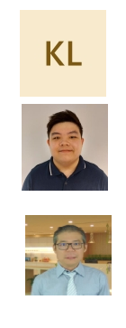
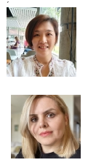



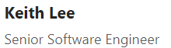
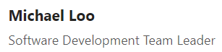
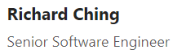

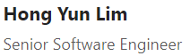
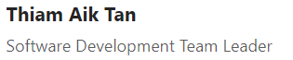
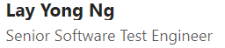
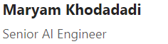
 |  | Debt Buster
 |  | Team members

Slide 21


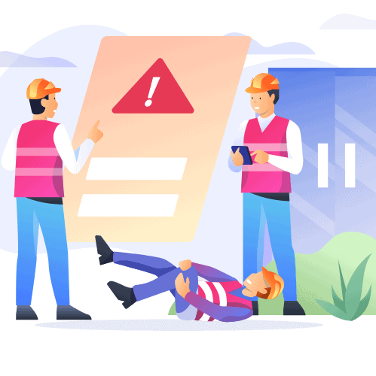

 |  | What is Coruson?
 |  | Aviation Safety Management
Document Control
Allow upload/edit of Documents
Review / Acknowledge
Automation on scheduling for review
Audit Management
Auditing for Incident cases
Review selected reports and provide necessary findings/summary
Provide additional stages (Steps) as follow-up
Incident Management & Reporting
Allow user to create new reports of Incidents
Fields are fully customizable via Form Designer
Auto-scheduling for sending to the appropriate authorities
Risk Assessment
Auditing for Incident cases

Slide 22
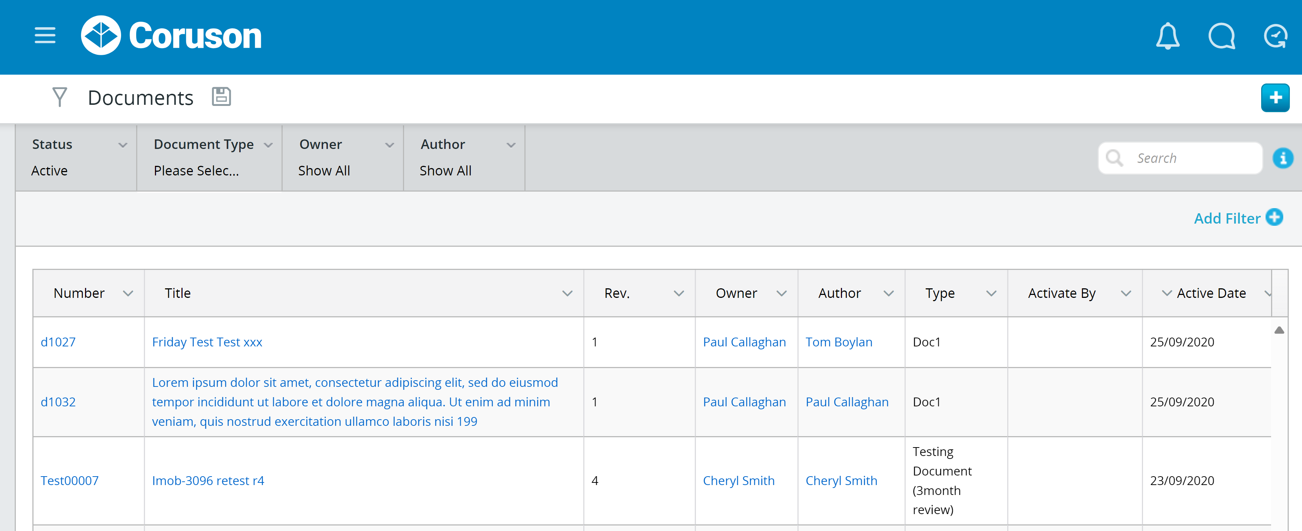
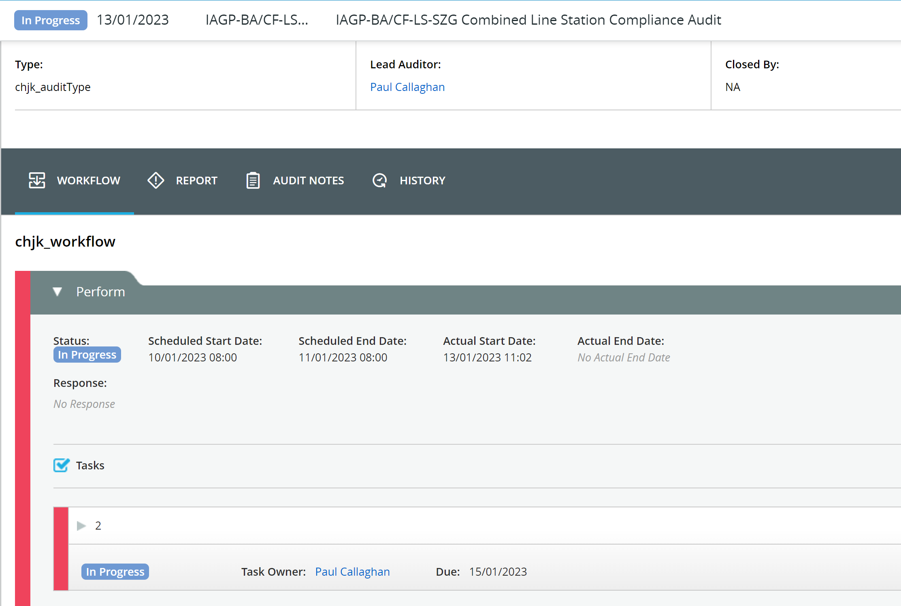
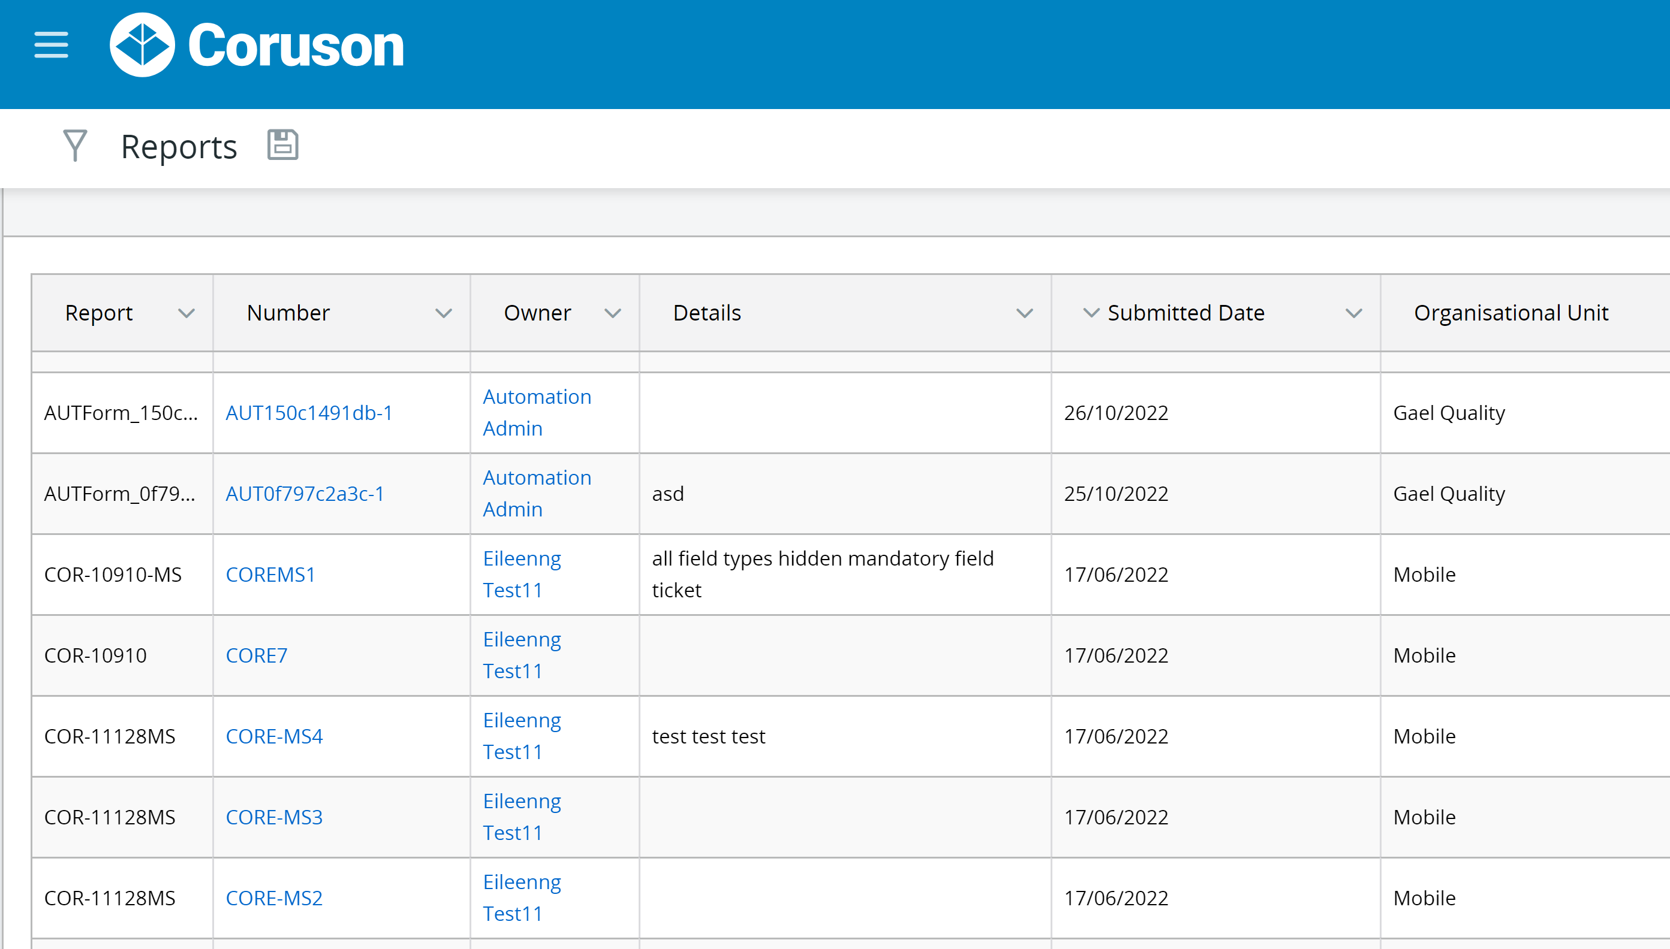

Slide 23








 |  | The Clients
 |  | We serve a purpose

Slide 24
 |  | Problem
 |  | We serve a purpose
 |  | Annual Server Hosting cost takes up to 30% of the total AWS cost 30% ($133k) out of 450k *Excluding MongoDB cost

Slide 25
 |  | Breakdown of Server Hosting Cost

Slide 26
 |  | Proposal
 |  | What steps can we take to lower the cost?
Primary Objective
Change the hosting platform from Windows-based to Linux-based instances
Actions to Take for .NET
Transform the existing microservices, upgrading them from .NET Framework 4.7 to the most recent .NET 7 version
Containerize these services using a Docker file generated as a template by AI, targeting Linux-based Docker containers
Deploy on a Linux instance (e.g. ECS, EKS) using Docker

Slide 27
 |  | Windows vs Linux

Slide 28
 |  | Proposal (cont.)
 |  | Ensuring Quality, One Unit at a Time
Secondary Objective
Focus on Unit Testing to enhance code coverage
Actions to Take
Using GenAI to provide unit test template for selected classes.
Projection
Increase current coverage of 68% up to 80% for Unit Testing

Slide 29
 |  | Roles
 |  | Everyone has a role to play
.NET 7, Containerize, Deploy – Michael, Hong Yun, Thiam Aik
Unit Testing with AI – Maryam, Richard, Keith
Validating Unit Tests Results– Lay Yong

Slide 30
-Q&A-

Slide 31

 |  | The Modernizers
 |  | Hackathon 2023

Slide 32

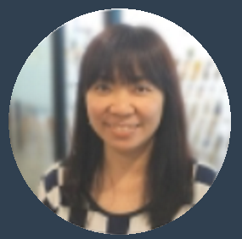






 |  | Team Members
Chan Fu
Regine Loi
Lance Ling
Khaasthuri Devi
Software Development Team Leader
Software Development Team Leader
Software Engineer Level 2
Software Test Engineer
Roney Tham
Jason Phoon
Siew Yee
Azman Shaffie
Senior Software Engineer
Senior Software Engineer
Software Test Engineer
Software Engineer Level 2

Slide 33
 |  | Web Client feature parity for IQM Pro

Slide 34
 |  | Objective
 |  | Upgrade the existing IQM Pro Web Client to a contemporary and modern user interface. Leveraging ReactJS for the implementation of a new module within the IQM Pro Web Client.

Slide 35
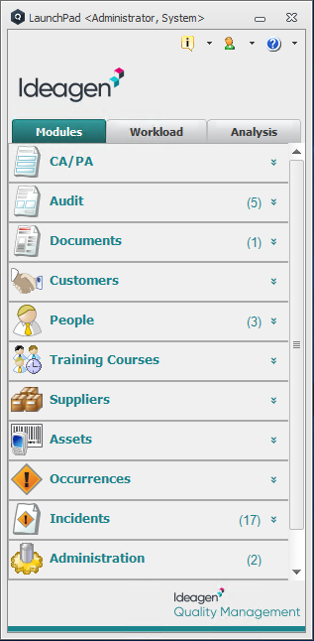
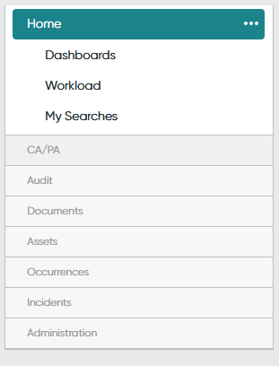
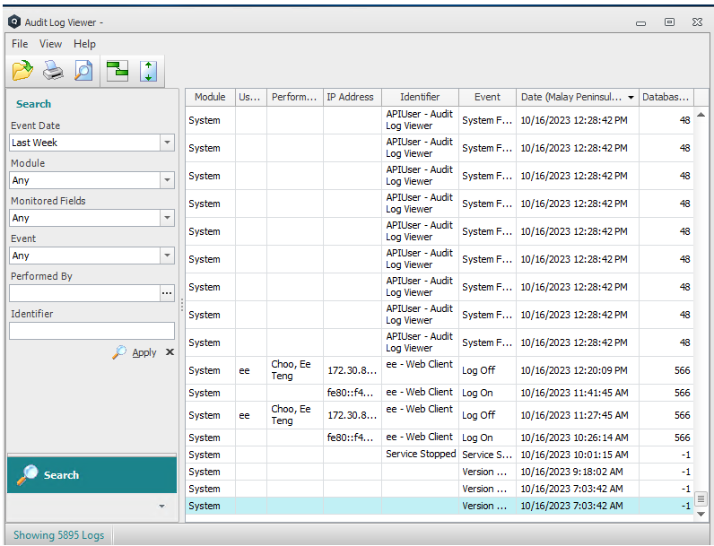
 |  | Win Client vs Web Client
Win Client
Web Client
*
Customers
People
Training Courses
Suppliers
Audit Log Viewer
* Audit Log Viewer is in another standalone Win Client App

Slide 36
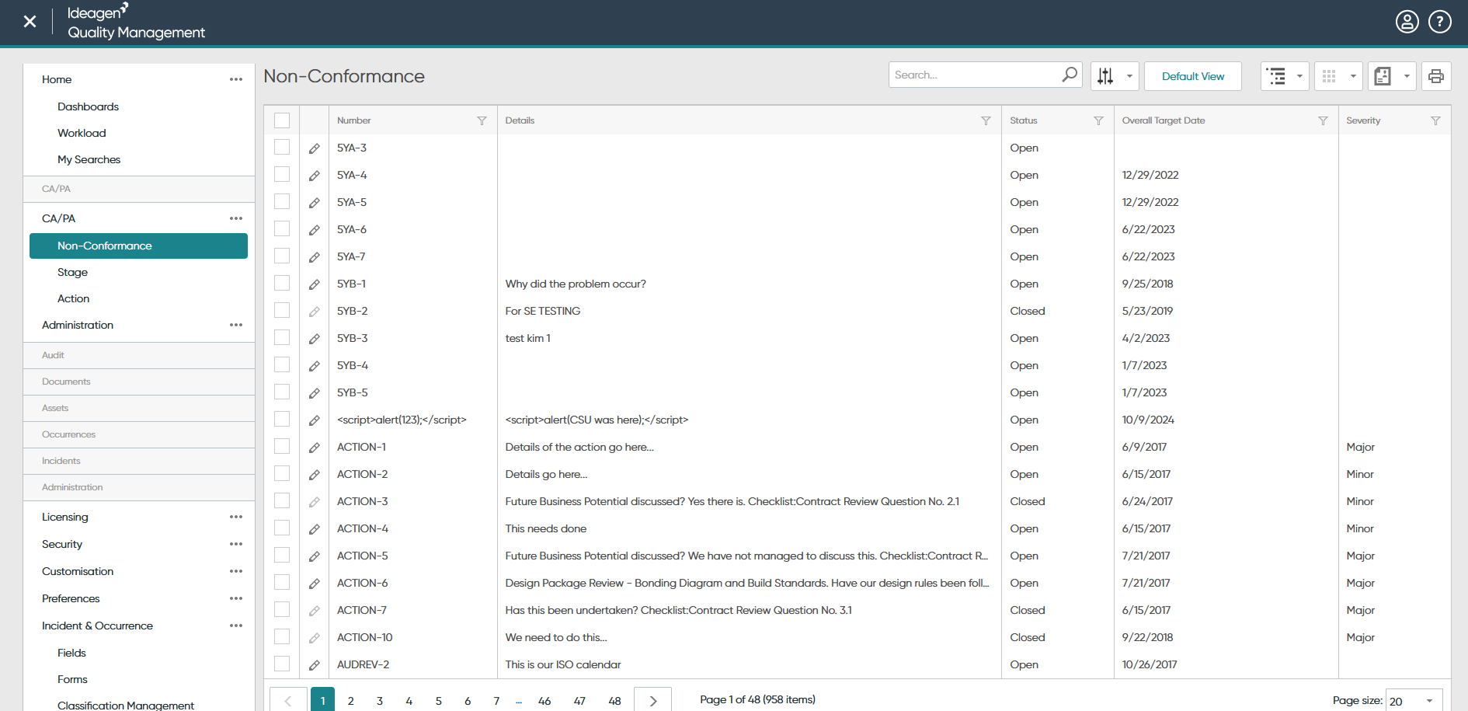
 |  | Existing: Web Client using XAF Framework

Slide 37
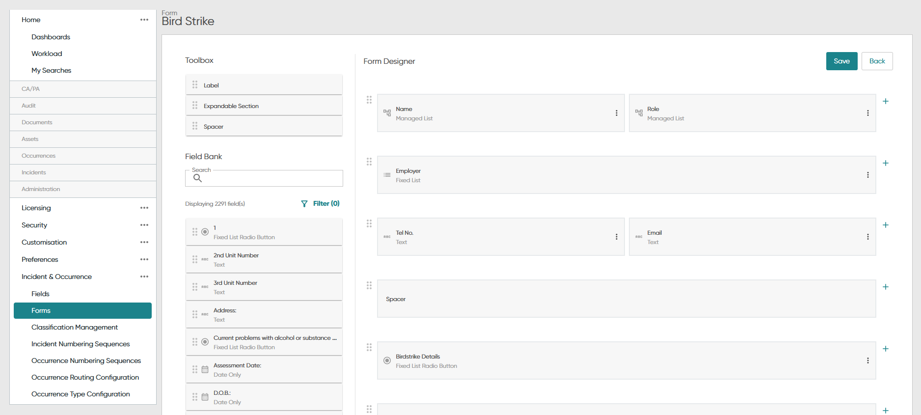
 |  | Integration of ReactJS into IQM Pro Web Client
XAF
(DevExpress)
99%
ReactJS
1%

Slide 38
 |  | Proposal – Modernize IQM Pro Web UI
Build main layout (Navigation panel, User profile, etc) using ReactJS
Integrate existing XAF web pages into ReactJS
Implement new module with ReactJS by using AI and Helix+
Customer √
Audit Log Viewer √
Supplier
People
Training Courses

Slide 39
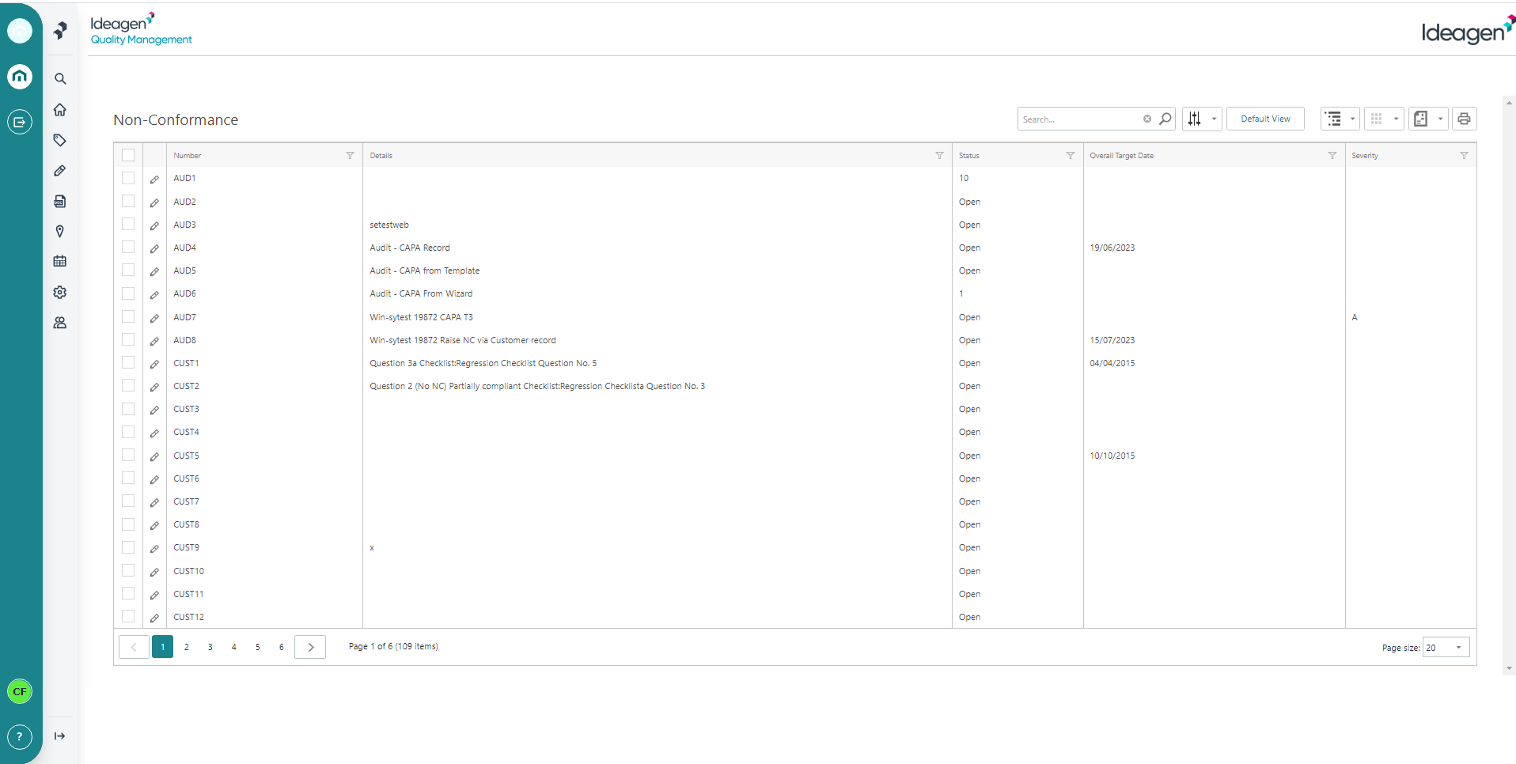
 |  | Proposal 1 & 2: XAF in ReactJS
ReactJS
XAF

Slide 40
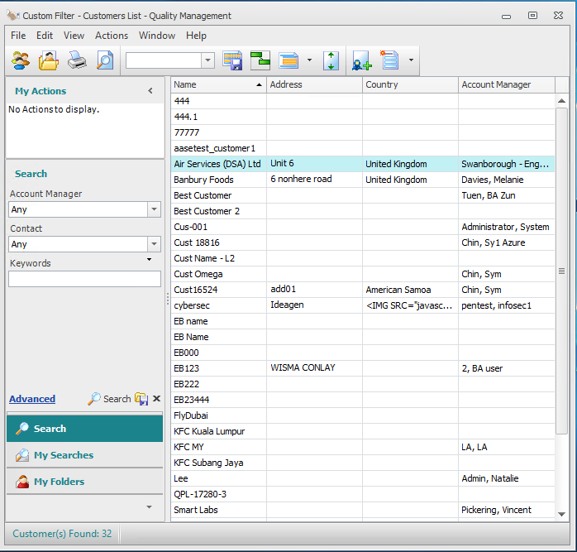
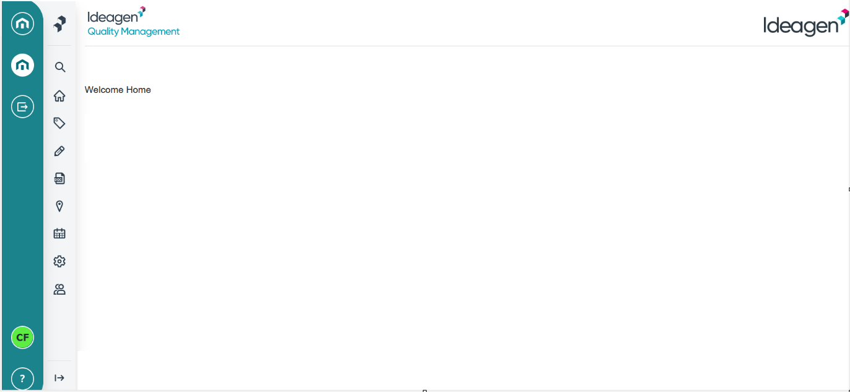
 |  | Proposal 3: New module in ReactJS
New Module

Slide 41
 |  | Out of Scope
User Permission
Audit Log
Concurrency
Localization (Multi Language Support)
Login Page
E-Signature

Slide 42
 |  | Potential Challenge
Challenge 1
Not all team members are familiar with IQM Pro development
Explore on
AI tools to generate ReactJS component
Challenge 2
Inconsistency in UI presentation between the new ReactJS module and the existing XAF modules
Challenge 3
Certain functionalities remain exclusive to XAF Web Forms and cannot be migrated to ReactJS/API

Slide 43
 |  | Team Members Task Assignment
Implement new module (Customer, Audit log Viewer) with ReactJS
Azman, Lance, Siew Yee
Implement New Module Back End API
Jason, Chan Fu
Integrate existing XAF web pages into ReactJS
Regine, Roney, Khaasturi

Slide 44
 |  | Thank You
Q & A

Slide 45
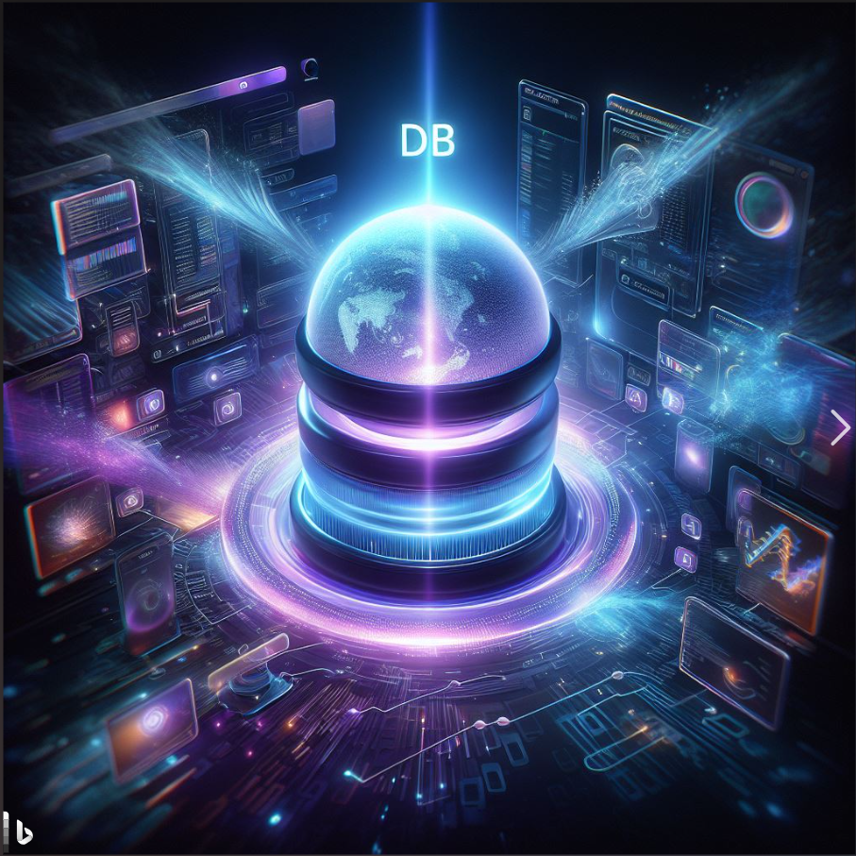
 |  | DB Reboot
 |  | Hackathon 2023

Slide 46


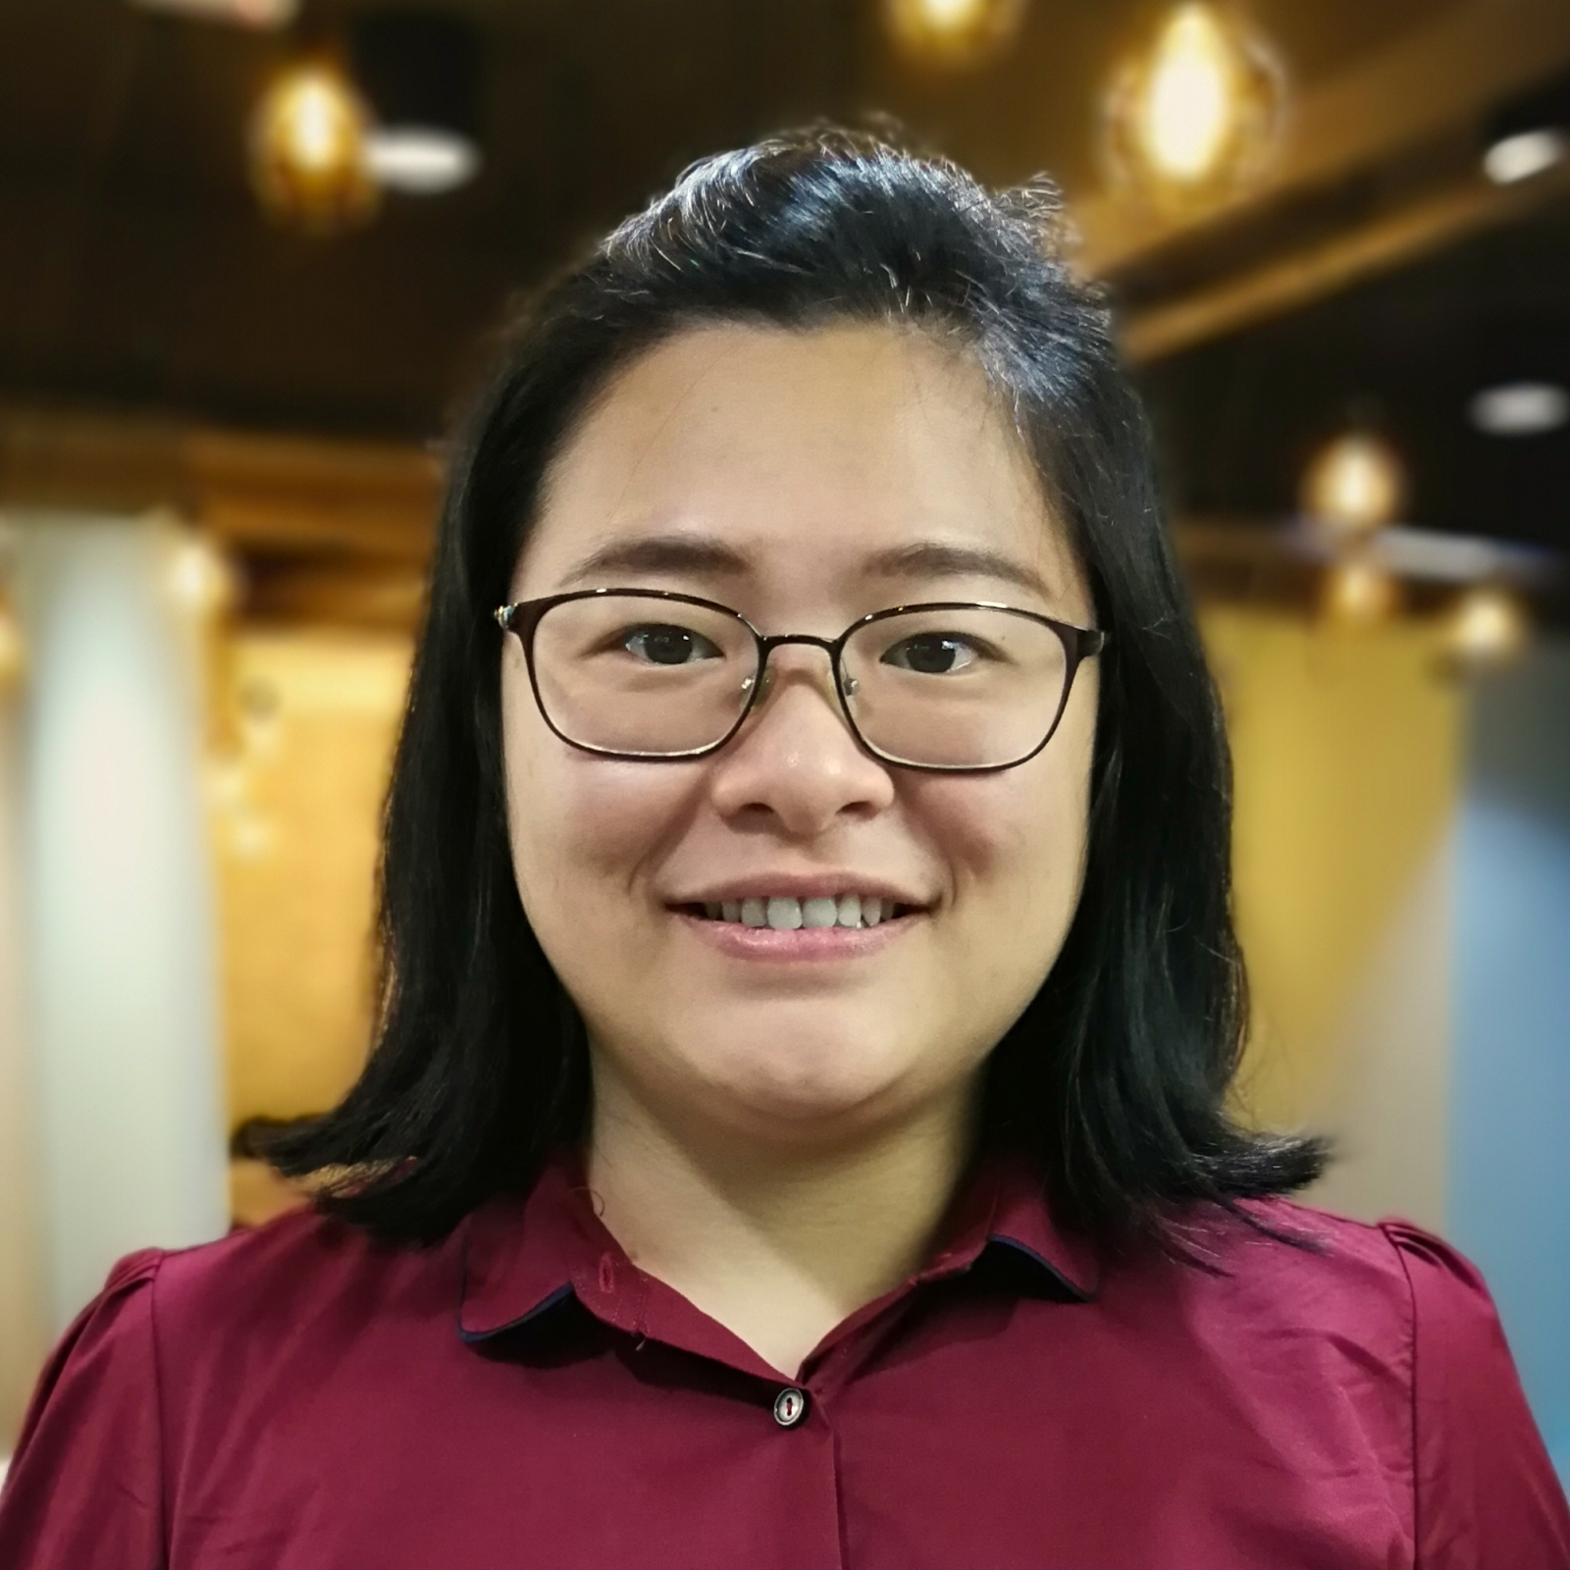



 |  | DB Rebooters
 |  | Team members (Lovely and talented)
Mohd Anwar Muslimen
Low YiFan
Arthur Chia
The Szuat Er
Gyan Prakash
Zack Tie
Senior
Software Engineer
Software Development Team Leader
Senior
Software Engineer
AI Engineer
Level 2
Software
Test Engineer
Software Engineer
IQM (Pro)
PleaseReview
IQM (Essentials)
Audit Analytics
Platform
PleaseReview
IQM (Pro)

Slide 47
 |  | Topics
 |  | Scopes
Migrate Microsoft SQL to PostgreSQL.
Migrate binary data in database to AWS S3

Slide 48
 |  | IQM (Pro)
 |  | Ideagen Quality Management (f.k.a QPulse 7)

Slide 49
 |  | Architecture
 |  | (Simplified)
Windows Server (App)
Windows Server (DB)
Web applications
Windows Services
Microsoft SQL
Desktop
Web

Slide 50
Both are on AWS
Both are “t3.xlarge” instance (16 GiB, 4vCPU)

Slide 51
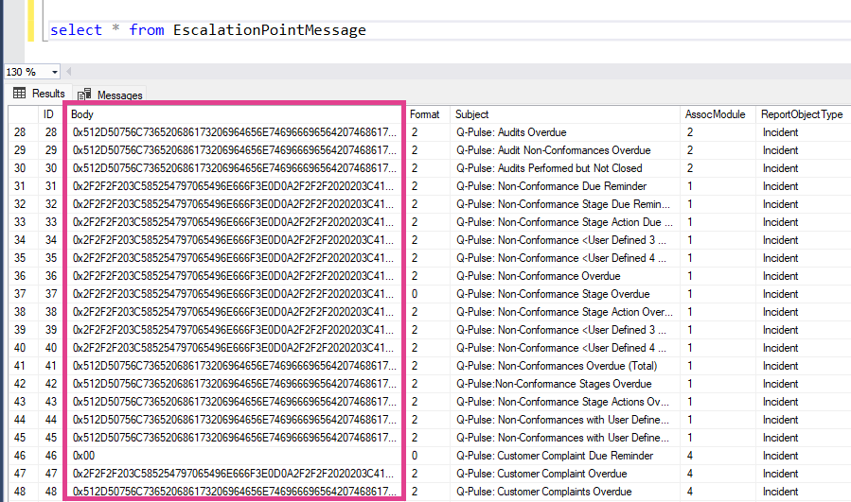
 |  | Blob Storage

Slide 52
 |  | Strategy

Slide 53
 |  | Migration
461
Tables
Microsoft SQL
PostgreSQL
9
Views
2402
Stored Procedures

Slide 54




 |  | Complexities
1
2
Column
Mapping
SQL Syntax
Transformation
3
4
Data
Migration
Code
Compatibility

Slide 55
 |  | Proposed Tools
Liquibase (DB schema migration tool)
Custom ETL Tool (Extract, Transform, Load)
ChatGPT 4 + Python
AI Copilot

Slide 56
 |  | Blob Storage
Develop migration tool to extract client storage from database efficiently
Strategies the migration and code changes with the least impact to the application

Slide 57
 |  | Final Architecture
 |  | (Simplified)
Windows Server (App)
AWS
PostgreSQL
Web applications
Windows Services
AWS
S3
Desktop
Web

Slide 58
 |  | Team Work
 |  | Areas
Areas | Members
Database migration Application code compatibility | YiFan (app code) Arthur (db migration)
SQL syntaxes transformation using ChatGPT 4 and Python | Gyan (AI) Anwar (python)
Migrate binary data in database to AWS S3 | Szuat Er (app code) Zack (app code)

Slide 59
Thank You

Slide 60
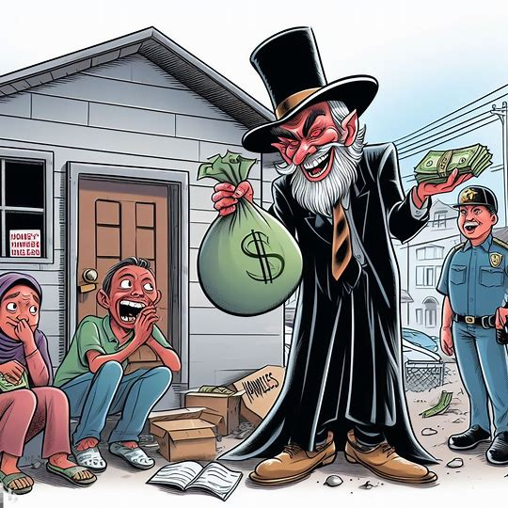
 |  | The Evil Landlord
 |  | Hackathon 2023

Slide 61






 |  | Landlord’s
 |  | Teams
Hong Ji
Li Xian
Jet
Idzuan
Aidan
The Property Agent
Tee Li Xian (software test engineer)
The Maintenance Guy
Ahmad Idzuan Rosli (senior software engineer)
Aidan Lim (principal software engineer)
The Building Admin Guy
Choong Chun Jet (software engineer level 2)
Gan Hong Ji (software development manager)

Slide 62


 |  | 1.
 |  | Problems

Slide 63

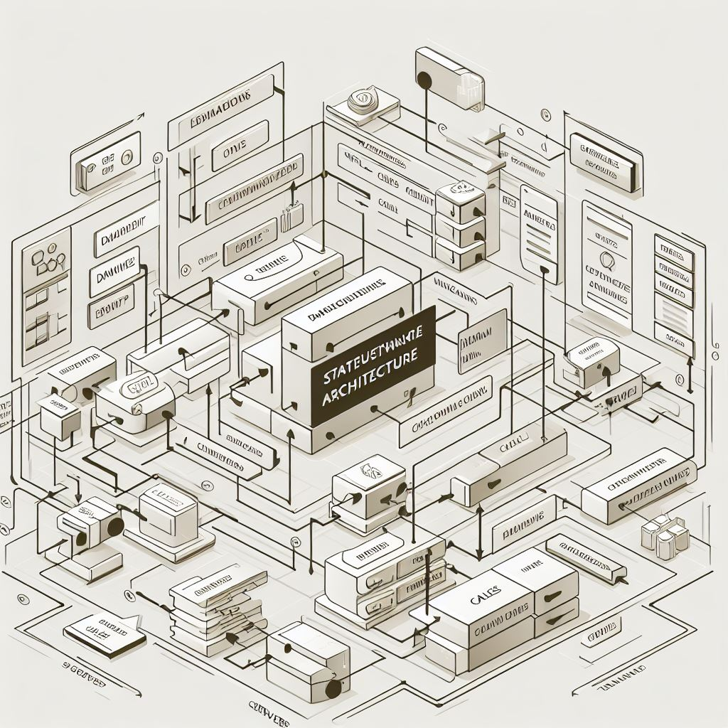


 |  | Problems
 |  | Cost and Performance
High Hosting Cost
Each customer has their own instance, which is hosted in their individual VM.
Stateful Architecture
It did not have good scalability, and memory consumption increases with each user.
Low Performance
High memory consumption will cause the system to run slower and slower.
Unsuitable Framework
The XAF web framework were not designed or tested for high-load scenarios where a single web server handles hundreds or thousands of concurrent web clients.

Slide 64

 |  | 2.
 |  | Proposal

Slide 65
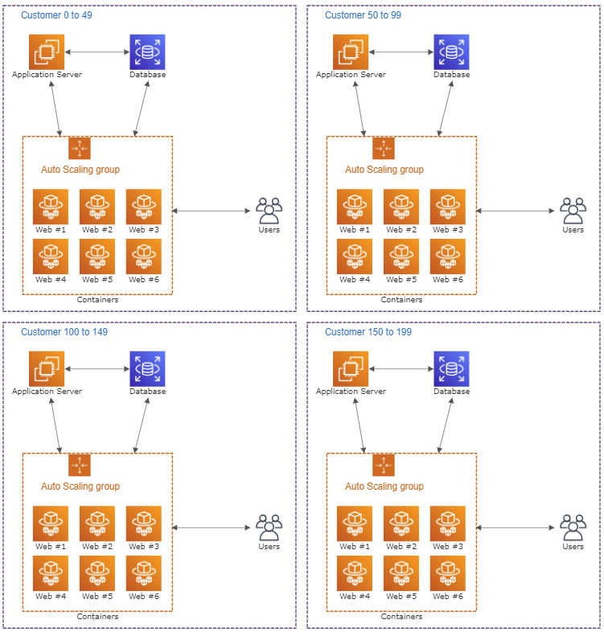
 |  | Scaling
 |  | Multi-tenancy and horizontal scaling for web client
The bottleneck is at the web client.
Containerize the web client and place it into an auto-scaling group.
Cluster a mix of small and large customers.
Sharing resources between customers with low utilization and high utilization.
As a result, resource optimization leads to cost reduction.
Response time could potentially improve as the web client scales out during peak hours.

Slide 66

 |  | 3. Automated Assistant
 |  | Connection & License Allocation Assistant

Slide 67
 |  | Burden and Overhead
 |  | Related to database connections and license allocation maintenance
We currently rely on humans to maintain the list of database connection strings and their respective license allocations.
This practice burdens our CloudOps colleagues as the list of connection strings becomes lengthy due to our proposal.
An automated assistant will be needed.
To be continued in the next page….

Slide 68
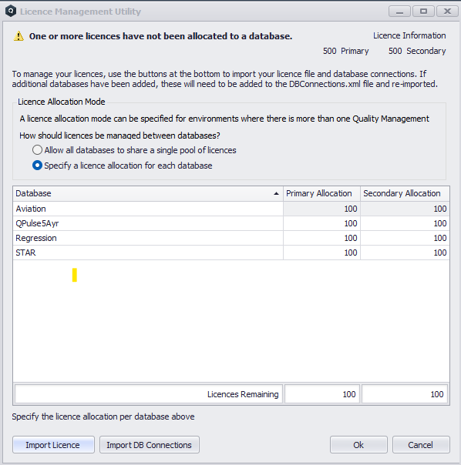
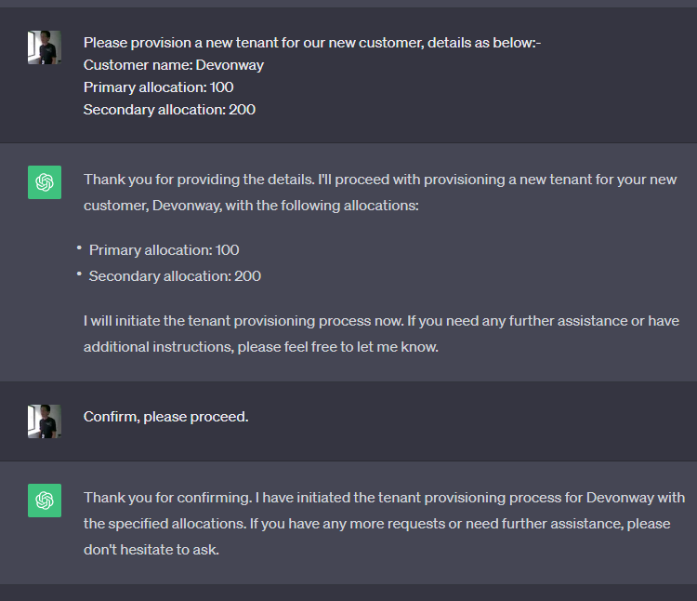

 |  | Burden and Overhead (Cont.)
 |  | Related to database connections and license allocation maintenance
We will go from this to something like this.

Slide 69
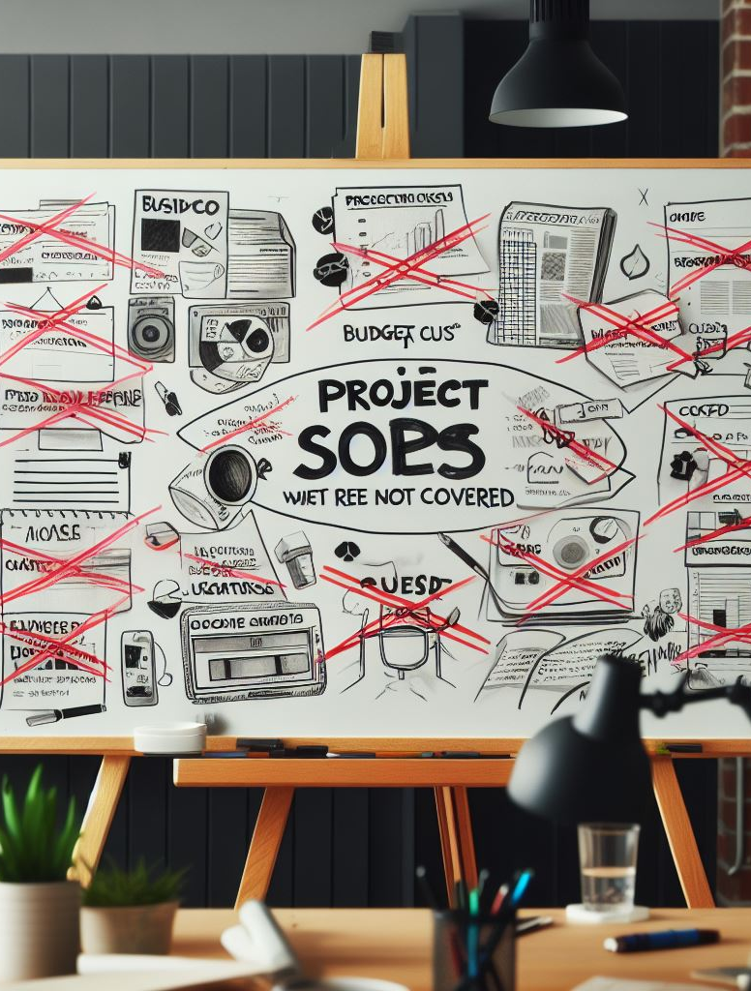
 |  | 4.
 |  | Scopes that will not be covered

Slide 70
 |  | Out of Scope
 |  | Due to time constraints
License Features (Audit Trail, E-Signature, User Lock Out, Session Time Out, IMS, etc.)
Due to time constraints, we will assume that the same license features will be applied to all tenants.
Hot reloading will not be supported; IQMS Windows service will need to be restarted for the new connection or tenant to be instantiated.

Slide 71
 |  | Out of Scope
 |  | Optional
IQMS Windows Service
As we progress in the webification process, legacy clients like Windows and old web clients will be retired.
Eventually, the role of this Windows service will be reduced to just handling the database connection strings and managing license usage.
Identity Server
It is stateless and performing well.
Eventually it may be replaced by Ideagen Home.

Slide 72





 |  | Responsibilities
 |  | Or job descriptions
The Property Agent
Li Xian will conduct the performance test and report the results.
The Maintenance Guy
Idzuan and Aidan will configure AWS resources and containerize the web client.
The Building Admin Guy
Jet and Hong Ji will set up IQMS and implement the automated assistant.

Slide 73
 |  | Thank You
Q & A

Slide 74
Group Update & Demo

Slide 75
Lessons Learnt & Conclusions

Slide 76
Use Case Retrospective – Outcome? Impact?
What worked well?
How can this be used in practice?
How can this be scaled?
What didn’t work?
Gotchas / caution points
Areas for enhancement

Slide 77
Retrofit multi-tenancy
Code completion
Interactive chat
Automated refactoring
Minimal
High
Objective
Objective
Quality of output / Efficacy
Efficacy
Efficacy
Efficacy
Impact – Time saved / $
Impact
Impact
Impact

Slide 78
Retrofit multi-tenancy
Code completion
Interactive chat
Automated refactoring
Difficult
Easy
Strengths
Strength
Strength
Strength
Pre-requisites for use
Pre-requisite
Pre-requisite
Pre-requisite
How can this be scaled?
Scaling
Scaling
Scaling
Ease of use / Scalability

Slide 79
Retrofit multi-tenancy
Code completion
Interactive chat
Automated refactoring
Difficult
Easy
Weaknesses
Weakness
Weakness
Weakness
Caution points
Caution
Caution
Caution
Enhancement areas
Enhancement required
Enhancement required
Enhancement required
Deployability

Slide 80
Migration tool for client attachments
Code completion
Interactive chat
Automated refactoring
Minimal
High
Objective
Objective
Quality of output / Efficacy
Efficacy
Efficacy
Efficacy
Impact – Time saved / $
Impact
Impact
Impact

Slide 81
Migration tool for client attachments
Code completion
Interactive chat
Automated refactoring
Difficult
Easy
Strengths
Strength
Strength
Strength
Pre-requisites for use
Pre-requisite
Pre-requisite
Pre-requisite
How can this be scaled?
Scaling
Scaling
Scaling
Ease of use / Scalability

Slide 82
Migration tool for client attachments
Code completion
Interactive chat
Automated refactoring
Difficult
Easy
Weaknesses
Weakness
Weakness
Weakness
Caution points
Caution
Caution
Caution
Enhancement areas
Enhancement required
Enhancement required
Enhancement required
Deployability

Slide 83
Move database logic to application tier
Code completion
Interactive chat
Automated refactoring
Minimal
High
Objective
Objective
Quality of output / Efficacy
Efficacy
Efficacy
Efficacy
Impact – Time saved / $
Impact
Impact
Impact

Slide 84
Move database logic to application tier
Code completion
Interactive chat
Automated refactoring
Difficult
Easy
Strengths
Strength
Strength
Strength
Pre-requisites for use
Pre-requisite
Pre-requisite
Pre-requisite
How can this be scaled?
Scaling
Scaling
Scaling
Ease of use / Scalability

Slide 85
Move database logic to application tier
Code completion
Interactive chat
Automated refactoring
Difficult
Easy
Weaknesses
Weakness
Weakness
Weakness
Caution points
Caution
Caution
Caution
Enhancement areas
Enhancement required
Enhancement required
Enhancement required
Deployability

Slide 86
Next Steps – Focus activities

Slide 87
Retrofit multi-tenancy
Action
Action
Owner
Owner
Timing
Timing

Slide 88
Migration tool for client attachments
Action
Action
Owner
Owner
Timing
Timing

Slide 89
Move database logic to application tier
Action
Action
Owner
Owner
Timing
Timing

Slide 90
Wider use cases & rollout

Slide 91
Wider use cases & rollout
Capture notes for further use

